Slide 1

ALTO Implementation and Deployment Supporting CERN (FTS/Rucio Integration)
Presenter: Jordi Ros Giralt, Y. Richard Yang, Mario Lassnig
March 27, 2023
IETF 116
Notes:
https://datatracker.ietf.org/doc/draft-ietf-alto-new-transport/
https://datatracker.ietf.org/doc/draft-schott-alto-new-transport-push/

Slide 2
Outline
Review and recap
Main design summary
Document status
Remaining issues

Slide 3
Scope: Transport Resource Scheduling
Transport scheduling: decides
when to start the transport of a transfer request,
with how much transport resource
Transport resource broadly defined: networking transport, storage transport, memory buffer used for transport
Benefits of well-designed transport scheduling
Efficiency: not overwhelm transport resources, not leave resources on the table
Multiplex sharing: multiple users coexist and share the resources with control, extract statistical multiplexing gain
Application-level objectives: schedule according to application needs
Notes:
Careful w/ the wording, gap

Slide 4
Existing Transport Scheduling Work: Internet & Hyperscaler
Many existing transport scheduling mechanisms developed for the general Internet and hyper-scalers, e.g.,
Layer 3 (networking) QoS/DiffServ
L4 transport congestion control, TCP congestion/rate control
TCP/Reno, TCP/Cubic, and BBR
Data center/hyperscaler transport scheduling
DCTCP, fastpass, entilement, SD-WAN (e.g., B4, SWAN), Co-flow (e.g., Sincronia)
Notes:
Careful w/ the wording, gap

Slide 5
TCN/ADN: Strong, Flexible Resource Allocation Model on Top of Weak, Universal Control Knob
Resource model: flexible resource model
Control knob: universal ability to launch TCP transfer

Slide 6
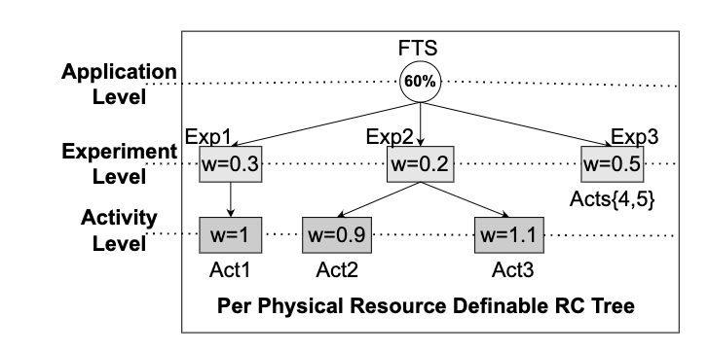
Big Picture
Pipe[i].src
Pipe[i].dst
AS 1
AS 2
AS 3
Controller (ALTO/TCN Extension for FTS)
Resource control spec
Resource use visibility: Pipe ->Asset
Scheduler: concurrency level, time multiplexing
Trans q1
Trans q2
Trans q2

Slide 7
ALTO/TCN Control Extension for FTS: Big Picture
Pipe[i].src
Pipe[i].dst
AS 1
AS 2
AS 3
Controller (ALTO/TCN Extension for FTS)
Resource control spec
Resource use visibility: Pipe ->Asset
Scheduler: concurrency level, time multiplexing
Trans q1
Trans q2
Trans q2

Slide 8
ALTO/TCN Control Extension for FTS Scheduling: Main Design Goals, Features and Benefits (Overview)
Efficient, shared data transport infrastructure through application-layer scheduling, complementing other layers (e.g., assume given L3)
Build on FTS
Goal | ALTO/TCN Control Extension | FTS Base
Efficiency | Optimize global objective using full gradient ⟹ Avoid non-Pareto-optimal solutions. | Optimize the throughput of each pipe independently; semi-gradient
 | Support both zero-order and first-order methods ⟹ Fast convergence. | Support only zero-order style gradient estimation.
Flexibility (Resource) control | Resource control as constraints ⟹ Support resource sharing | Resource control focusing on local protection
App-level control | Allow dependent flows ⟹ Support coflow scheduling. | Focus on individual flows.

Slide 9
FTS Current Design
Data-Intensive Workflows
Keeps transfer queue for each src/dst pair (pipe);
Adjusts # concurrent TCP connections per pipe;
Dispatches transfer if allowed by concurrency level
Data Management / Transfer Orchestration (e.g., Rucio)
Transfer Scheduling (e.g., FTS)
Transfer Data Plane
(e.g., GridFTP, XRootD, HTTP)
Multiple desirable properties
Provides a single scheduling point of coordination for multi-domains
Uses widely-available, easily deployable “control knob” to handle heterogeneity
Aware of app-level resource accounting
Adapts to multiple types of resources
Builds resource structures on top of TCP
Internet Transport Layer (e.g., TCP, TCP/Cubic, BBR)
Networking Layer (e.g., traditional networking, AutoGOLE/SENSE, NOTED, Programmable net)

Slide 10
FTS in General Transport Resource Scheduling
Transport scheduling: decides
when to start the transport of a transfer request,
with how much transport resource
Transport resource broadly defined: networking transport, storage transport, memory buffer used for transport
Benefits of well-designed transport scheduling
Efficiency: not overwhelm transport resources, not leave resources on the table
Multiplex sharing: multiple users coexist and share the resources with control, extract statistical multiplexing gain
Application-level objectives: schedule according to application needs

Slide 11

General Internet/DC Mechanisms and MPMD Data-Intensive Networks Gap
Mechanism | Gap
TCP Rate Control | TCP provides low level resource allocation; a MPMD data-intensive network may want higher level resource allocation structures
Datacenter/hyper-scaler Scheduling | Hyper-scaler is single domain w/ stronger controllability, and relative uniform deployment capability, but MPMD data-intensive network should support multidomain cluster with heterogenous domains Hyper-scaler scheduling focuses on highly diverse, low latency (ms-sensitive) workload, but data-intensive is more on less (RTT-level) delay-sensitive larger transfers

Slide 12
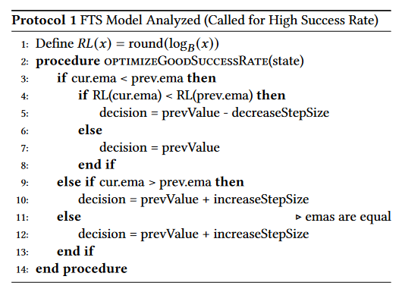
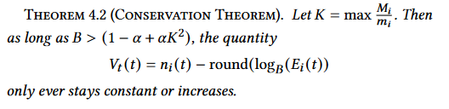
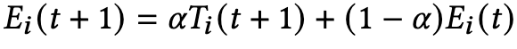
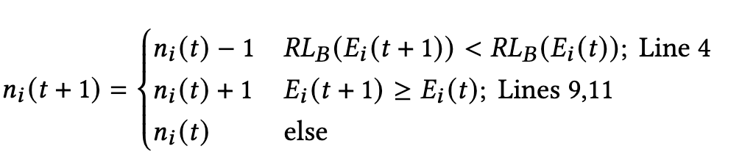
Current FTS Control Gap
resource flexibility gap
A Semi Zero-Order Gradient Alg Optimizing for Each Pipe
Keep track of the exponential moving average (EMA) of throughput.
Theorem: In a Throughput-Deterioration Model, semi zero order will achieve throughput that is <= 1/√B of the optimal (under default settings).
Update the number of connections based on EMA.
efficiency gap

Slide 13
ALTO/TCN Control Extension for FTS: Transport Scheduling as an Optimization Framework
Formulated ALTO/TCN scheduling planning as an optimization problem, in the form:
max fobj
s.t. flexible resource control as optimization constraints
Solve the optimization using a systematic gradient framework.
Three key design components and questions:
How to specify the fobj (Q1)? [See offline slide]
How to design/derive the gradients (Q2)? [See offline slide]
How to specify and handle resource control (constraints) (Q3)?

Slide 14
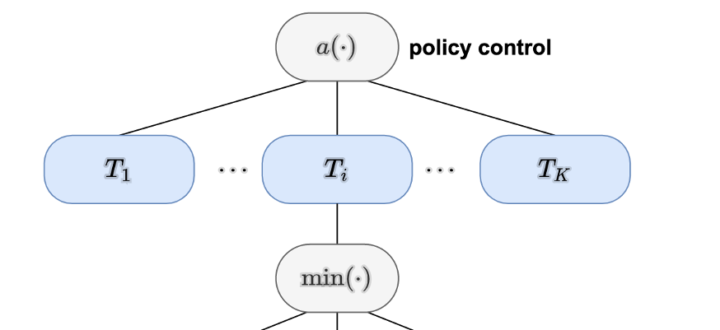
ALTO/TCN Global Objective Based on System Model
Map from multiple objectives to a single objective function using an aggregation function a() to aggregate performance across all pipes. Vary a() parameters to scan Pareto-optimal surface.
Bottleneck objectives can be composed using the min() function.
Current focus: each pipe objective represents bottlenecks, some with model (explicit) and some without model (implicit) objective.
fi1
fi2
Fi|Bi|
Notes:
Transition sentence: firstly, we specific the f_obj formulation.
Ryan’s Notes:
Resource Types: storage, network bandwidth,
The most constraining bottleneck is what we want to optimize.
Our policy control aims to optimize all throughputs, not just the total throughput (find pareto optimality).
To do this, we figure out how changing each link influences not just the throughput through that pipe -- which it obviously affects, but also its effect on other pipes.
a(): Throughput and Fairness
First vs. Zero-Order

Slide 15
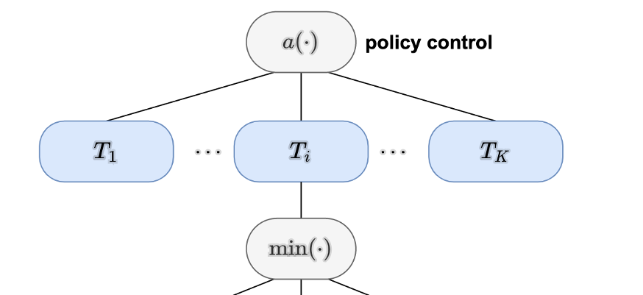
Q1: System Model and Objective Function
Project | Transfer | Pipe | Resource/link
Model
Ti = min {fij, j in Bi, where Bi is set of resources used by pipe i}
fi1
fi2
Fi|Bi|
u | t | i | j

Slide 16
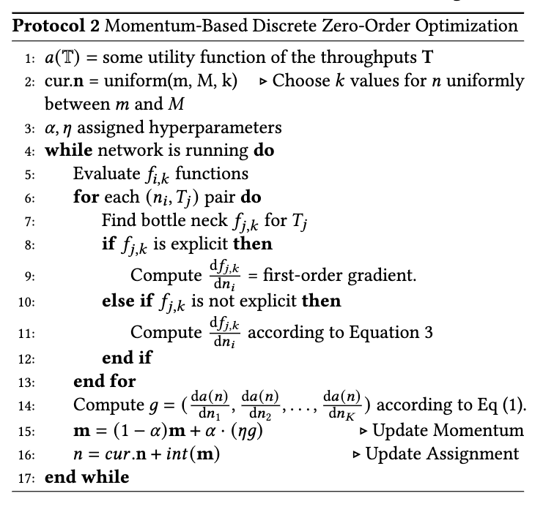
Detail: From Objective to Gradient (Algorithm)
Notes:
Within the TCN protocol, the goal is to
Mention: Exponential Moving Average of Estimates is preserved by the momentum condition.
f(n+z) = f(n) + grad * z

Slide 17
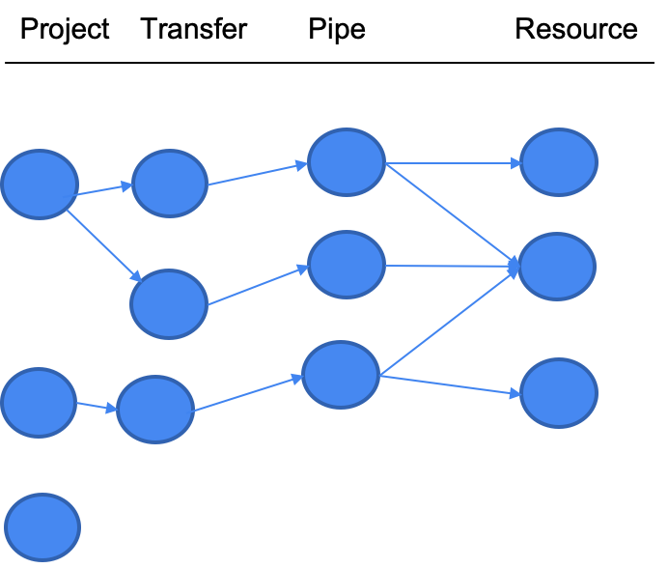
ALTO/TCN Basic Resource Control Specification (BRCSpec) and Integration into Gradient Computation
Basic resource control specification
<project, resource> -> resource-control
resource-control := abs-val-range | relative-weights
Map app-level (end-to-end) project use to resource use
ALTO mapping from pipe to physical resources (routing matrix)
resource use = sum of T_{j} that uses the resource
Integrating constraints in gradient computation
Penalty function on constraints violations
Specification
Map transfer
→ resource
Penalty added to the gradient.
Notes:
Transition: This framework allows us to integrate constraints.
Previously unconstrained, we introduce resource constraints.
> absolute value condition means min throughput guarantee. Relative weight depends on other transfers and is not directly related to throughput. It is a mean of giving priority without causing starvation.

Slide 18
Current ALTO/TCN Implementation: 3 Main Components
Data Flow Orchestration (build on Rucio)
Resource Control
Model
Scheduling of Data Movement Tasks (build on FTS Integration)
Visibility of Multidomain Infrastructure (e2e aggregation and select control assets)

Slide 19
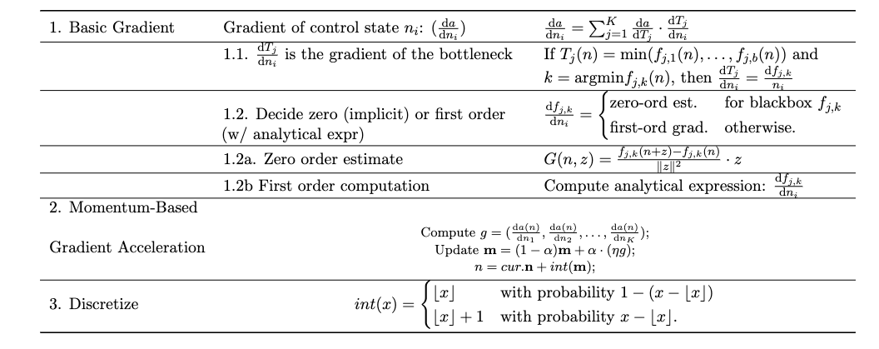
Offline: Q2: From Objective Function to Gradient (Derivation)
Optimization state workflow.
Notes:
Link to table: https://www.overleaf.com/8544893379cbkdzhmtwxkt

Slide 20
ALTO/TCN Scheduler in FTS
Integration into FTS 3.12
Implement ALTO/TCNOptimizer class for ALTO/TCN control loop
Add new optimizer mode (kOptimizerAggregated) to enable ALTO/TCN optimizer
Extend database schema for pipes (t_link_config) to support resource control specification (tcn_abs_limit, tcn_rel_weight)
Build network resource constraints using the ALTO path vector client library
Notes:
Transition sentence (at end of previous slide): To fully appreciate how the designs are realized, let’s first build a big picture view of TCN.
(1) create pipes specifying src and dst, as well as resource control requirements: the bounds and rel-weights.
(2) transport select (Rucio) pushes a transfer. Additionally, going beyond FTS, TCN supports ordering constraints
(3) 3 control loops, 3-alto: network resources info, 3-control n, 3-data: when transfer finished, guided by 3-control.
Important points:
1- TCN can aggregate the information among multiple networks using ALTO (One of the complexities given in the
There are three main control loops:
The ALTO execution loop updates the mapping from pipes to the network resources, and uses ALTO to obtain information about network resources . (is this the routing matrix * T matrix multiplication thing)

Slide 21
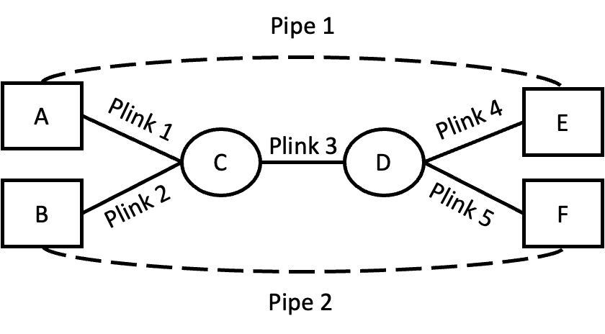
Q3: Basic Resource Control Specification (BRCSpec), Visibility, Gradient Computation Integration (Example)
Specification:
Project 1 pipes: Pipe 1, Pipe 2
R1: <Project 1, Plink 1> <= 5G
R2: <Project 1, Plink 2> <= 10G
R3: <Project 1, Plink 3> <= 10G
Control State at the interval:
Pipe1.traffic = 3G, Pipe2.traffic = 9G
Resource use:
Plink1.traffic = 3G, Plink2.traffic = 9G, Plink3.traffic = Pipe1.traffic + Pipe2.traffic = 12G
Routing Matrix Visibility (ALTO)
Pipe 1: {Plink 1, Plink 3, Plink 4}. Pipe 2: {Plink 2, Plink 3, Plink 5}.
Penalty for resource control constraints:
P(R1) = 0 (Plink1 = 3G <= 5G)
P(R2) = 0 (Plink2 = 9G <= 10G)
P(R3) = 2 (Plink3 = 12G > 10G)
Notes:
5,10G are absolute bounds.

Slide 22

Visibility Implementation using OpenALTO, openalto.org
openalto.org
OpenALTO is an open-source implementation and platform of ALTO (MIT License).
Available at https://github.com/openalto/alto
openalto.org is a running instance of deployment of OpenALTO, providing network information, in particular, in the context of data-intensive sciences, such as LHCONE.

Slide 23
Visibility Implementation Architecture and Design Space (Individual Network)
IETF ALTO Protocol as Front End
Backend Data Store
Other Sources
Control Plane
Data Plane Control: FIB
Data Plane Data: Sample
GeoIP
Config->FIB
FIB/DP driven
G2 snapshot
Samples (netflow, sflow)
PerfSonar (ICMP)
Equivalent Class
Looking Glass
P4
<switch interface , pkt attr>
<src, dst, <metric, val>>
adjac
subnets
BGP input

Slide 24
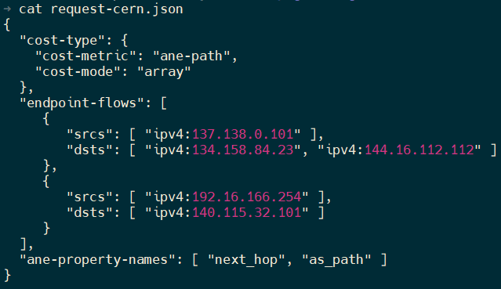
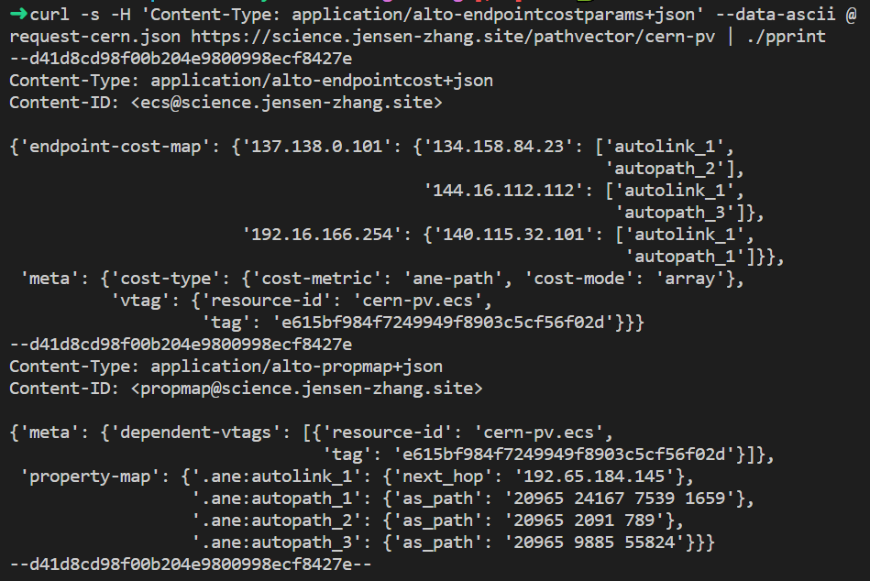
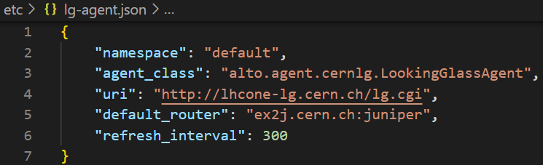
Visibility through FIB/LG Driven Implementation
Query Example (ECS with path vector extension)
Response Example (ECS with path vector extension)
Query/Response
FIB Retrieval (LG; deployment at CERN and GEANT)
Implementation
Jensen/Kai/Lauren

Slide 25
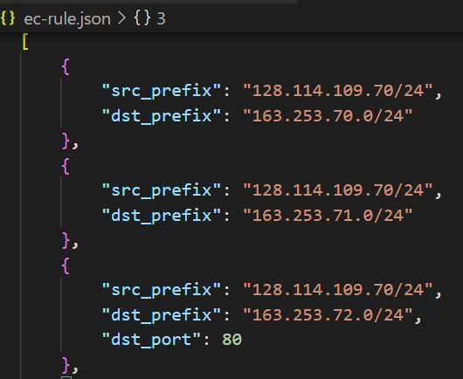
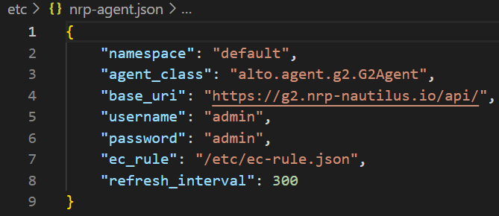
Visibility through Data Path Sampling Driven Implementation
DP Sampling + Equivalent Class (Deployment at NRP)
Jensen/Kai/Lauren/Sruthi

Slide 26
Outline
Motivation
ALTO/TCN for FTS Transport Scheduling
ALTO/TCN Visibility Design and Implementation
ALTO/TCN for Rucio Data Selection

Slide 27
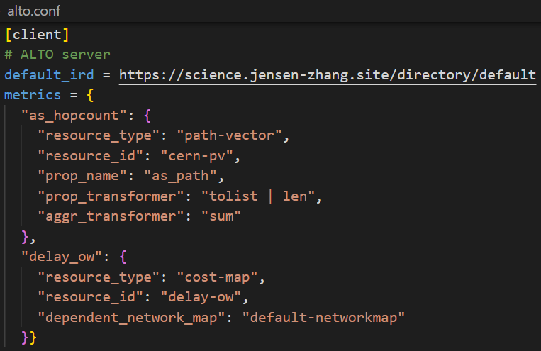
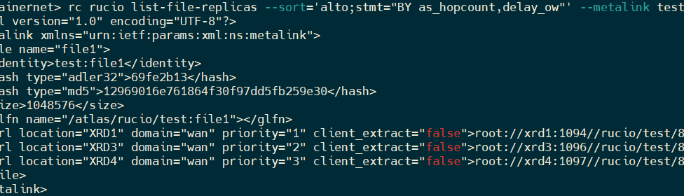
ALTO/TCN + Rucio: Sorting Replicas with Network-State Sorting Expression
Step 1: Configuration
Configure ALTO client at Rucio server to fetch visibility using ALTO
Step 2: Express Sorting Demands
ALTO sorting expression enables Rucio download command to sort replicas based on a combination of distances and properties
BY=as_hopcount,delay_owWHERE continent=”EU”
Map properties of ANEs into end-to-end metrics
Jensen/Kai/Lauren

Slide 28
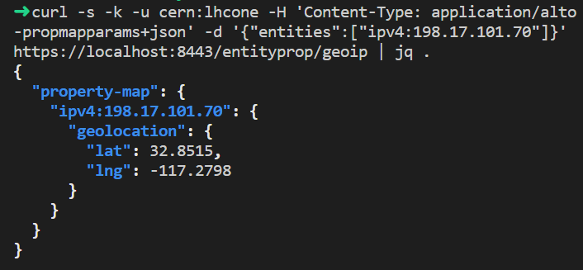
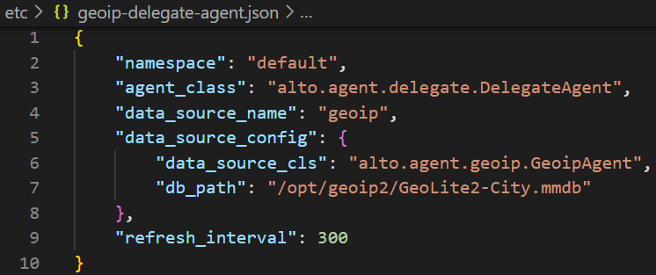
Visibility as Common Interface: GeoIP and GeoDistance
Providing geoip property using the standard ALTO endpoint property service [RFC 9240]
Providing geo distance between endpoints using the standard ALTO Endpoint Cost Service (ECS) [RFC 7285]
Query interface
Implementation Config
Notes:
Wording: Initial, not to change the default Rucio selecting data movement. GeoDistance is a default data movement selection mechanism in Rucio, and we now use alto to provide the standard implementation. Unifying the interface. Use download file; or use Web service

Slide 29
ALTO/TCN Extended Control Model and Resource Spec Model
Extended control model
Problem: only concurrency control is incomplete
Example 1: What if a single TCP connection can fully utilize the whole link
Example 2: Project 1 <= 30% of link cap
There is a background traffic of 1 TCP connection
n1 = 1 => 1/(1+1) = 50%,
n1 = 2 => 2/(1+2) = 2/3
n1 = 3 => 3/(1+3) 75%
Approach to address issue: time multiplexing on ALTO/TCN of concurrency control
Extended resource spec model
From rate/share spec to interval-rate spec, getting closer to the general service curve model
<interval, resource polytope>, e.g.,
[10, 30] , R1 >= 10TB

Slide 31
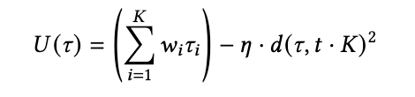
Fancier Algorithm
Integral, quadratic distance function
Zero-order stochastic rounding

Slide 32
Backup Slides

Slide 33
Basic Benchmarking ⇒ Real Topology (ESnet)
ALTO/TCN FTS
ALTO/TCN FTS
7.39x total BW utilization.
5.54x Max RCT improvement. (Short-tailed)
Global Objective, Zero-order gradients, and Resource Control Constraints.
Setting: 30 <src, dst> pipes, one request per pipe, each request 20K transfers, file size = 100MB. the total in the workload is 60TB.
Resource Control goal: all equal weights
Notes:
Key: Now that we have an understanding, let’s see if these are still true in a real ALTO/TCNology.
30 <src, dst> pipes, each pipe has 20K transfers, each transfer file size is 100MB, for a total 2TB per pipe, the total in the workload is 60TB
Transition: Next, For the system wide measures and static arrival patterns, we moved to a more complicated substrate network (ESnet) with 30 x 2TB transfers. We can see improvements in max BW utilization and Max FCT improvements. Our discussions with the CERN team indicates the importance of max FCT as the practical transmission times distribution of FTS is currently long-tailed.

Slide 34
Basic Benchmarking: Results
ALTO/TCN FTS
ALTO/TCN FTS
 | FTS Semi-Gradient (FTS-SG) | ALTO/TCN FTS
Total BW Utilization | Not optimal (6GB unused BW). | Fully utilized BW.
Resource Control | BW shares not satisfied. | BW allocated close to 2:1 spec.
RCT | Max RCT = 20,000 slots. | Max RCT = 4,000 slots.
FTS-SG depends on correct configuration (e.g., high enough default). ALTO/TCN is fully automated.
Notes:
a <src, dst> pipe (pair), 200K transfers, each transfer file size is 100MB, for a total 20TB
20TB 100MB each 200K transfers
Transition: For the system wide measures and time-slot 0 arrival patterns, we will start with the most simple case to show that FTS controller to show how FTS is superior in terms of adaptation to dynamic BW control conditions (component D) and optimality (components A and B). RHS TCN, LHS FTS.

Slide 35
Request Performance Distribution
2.03x mean RCT improvement.
2.49x max RCT improvement.
Global Objective, Zero-order gradients, and Resource Control Constraints.
ALTO/TCN FTS
Setting: Similar to previous slide, but with modification to include more requests to show more details: 100 <src, dst> pipes, one request per pipe, each request 5K transfers, file size = 100MB.
Resource Control goal: all equal weights.
Notes:
Key: Here, we are looking at individual transfers. This is the cumulative distribution function
100 <src, dst> pipes, each pipe has 5K transfers, each transfer file size is 100MB, for a total 500GB per pipe, the total in the workload is 50TB
Transition: Next we switch to more fine-grained metrics, to show the performance difference between TCN and FTS in terms of single-pipe characteristics. For a large number of flows on the ESnet ALTO/TCNology average flow completion time drops by a large factor if we change from the native FTS to TCN.

Slide 36
From All-Arrival Workload ⇒ Dynamic Arrival Workload
ALTO/TCN
ALTO/TCN
ALTO/TCN
ALTO/TCN
Setting: ESnet (67 nodes), selected 50 active pipes; each pipe has transfer workload arrives according to a arrival distribution (Poisson arrival, with parameter 1200 (every 200 time slot); Each replication request has N(40k, 20k) files, file size is 100MB.
8.0x improvement in RCT when using ALTO/TCN.
(Global Objective, Full Zero Order)
Notes:
In all previous simulations, all transfers arrive at the beginning. Let’s see what happens when they arrive one by one. Each of the 50 bars represents the individual flow completion time of each of the 50 transfers. Compared to FTS, we can see that TCN, in green, has bars 7 times smaller and thus 7 times faster. And this final evaluation shows the benefits of the TCN optimizer.
ESnet (67 nodes), selected 50 active pipes; each pipe has transfer workload arrives according to a arrival distribution (Poisson arrival, with parameter 1200 (every 200 time slot); Each replication request has N(40k, 20k) files, file size is 100MB.
Transition: Next we investigated the case where new transfers dynamically arrive to the system with an exponential time distance (every 200 time slots in average), transfer sizes is normal with an average of 4 TB.

Slide 37
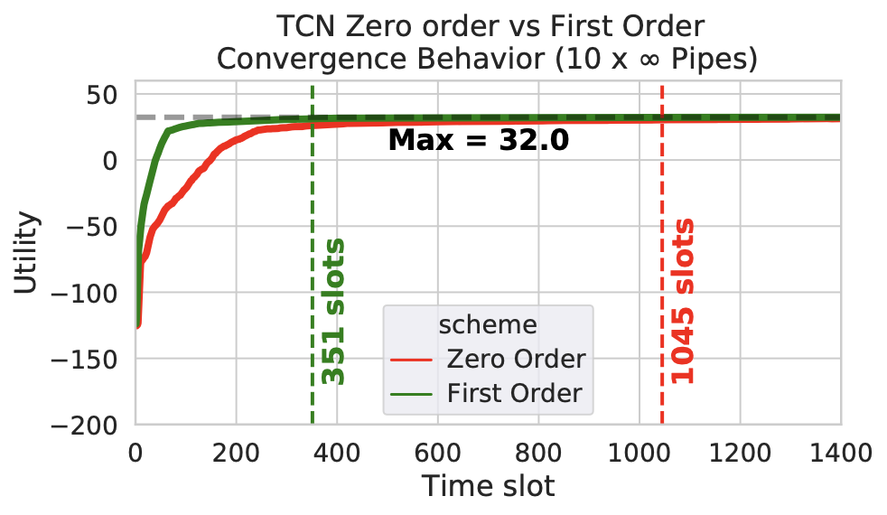
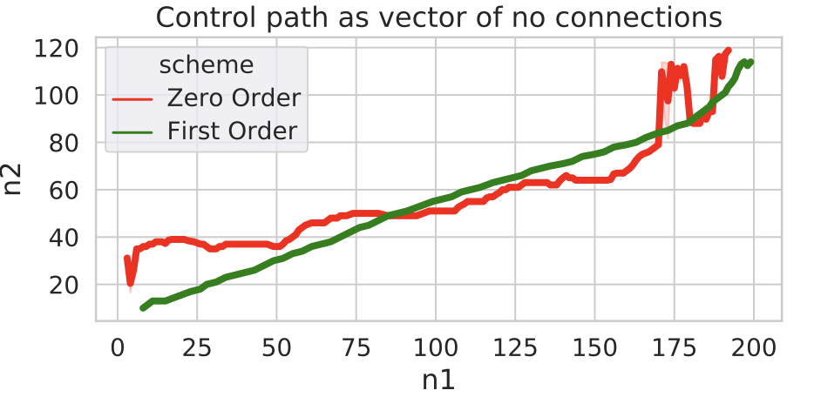
ALTO/TCN Zero-order vs First-order
ALTO/TCN
2.97x improvement in convergence speed (# transient slots) with using first-order gradients.
First-order integrated ALTO/TCN vs Full Zero-order ALTO/TCN
Setting:ALTO/TCNology ESnet, selected 10 pipes, infinite backlog.
Notes:
Red, Zero-Order: squiggly,, First-Order, Green: straight line.
ALTO/TCNology ESnet, selected 10 pipes, infinite backlog
Transition: One of the major novelties of TCN is the component C, using modeled optimization (e.g. bottleneck structure) TCN can accelerate convergence. As shown in the slide component C over B … LHS the path taken by the first two pipes. RHS: convergence speed and state.

